Slide 1





2 Your First Project in Power BI
Prepared By :
Said Fawzy
Manager of Information Center
Tendering Department
Arab Contractors

Slide 2

2 Your First Project in Power BI
Prepared By :
Said Fawzy
Manager of Information Center
Tendering Department
Arab Contractors

Slide 3

1
Power BI Components
2
Power BI Workflow
3
Exercise 1: Mini Project in Power BI

Slide 4
1
Power BI Components

Slide 5
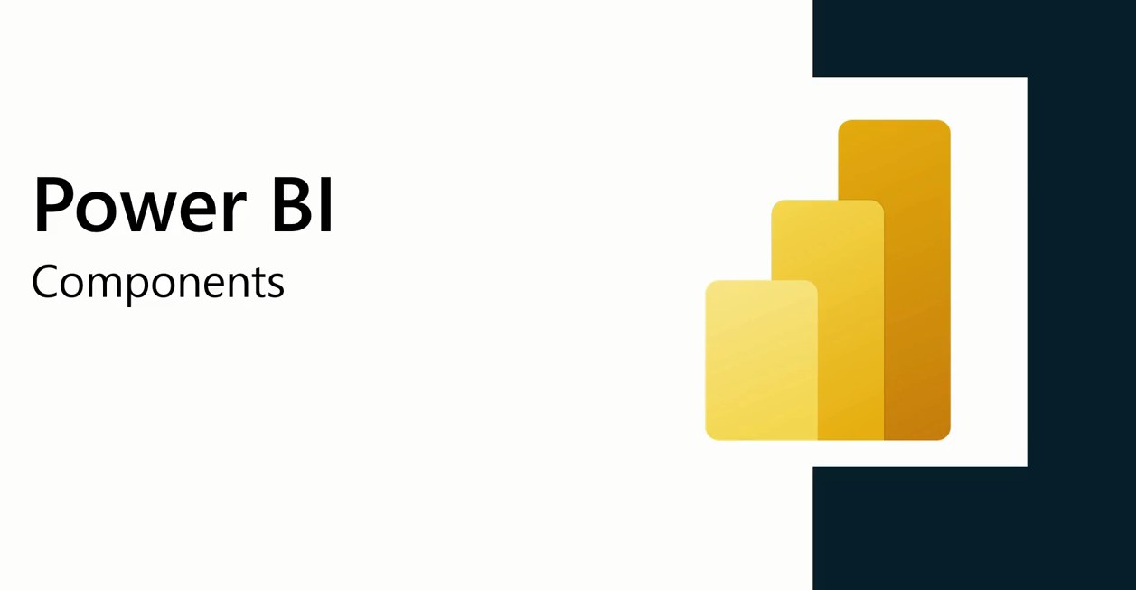

Slide 6
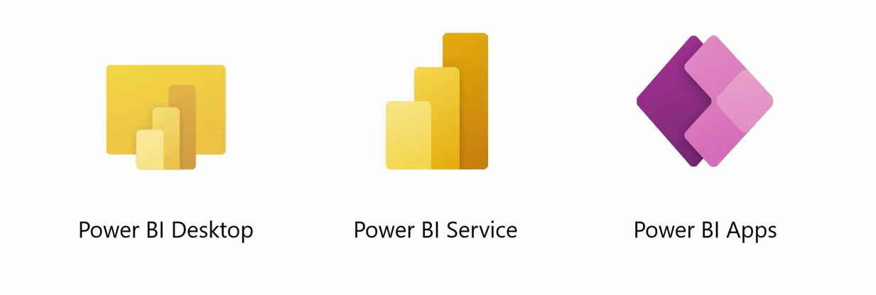

Slide 7
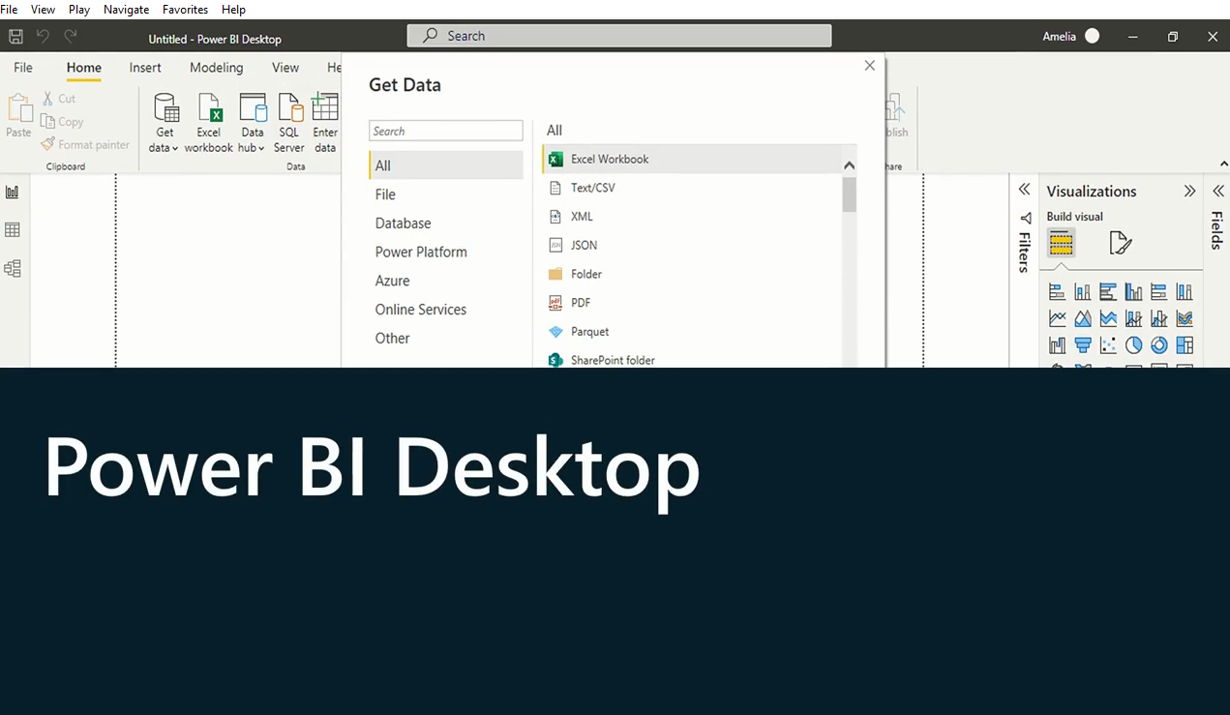

Slide 8
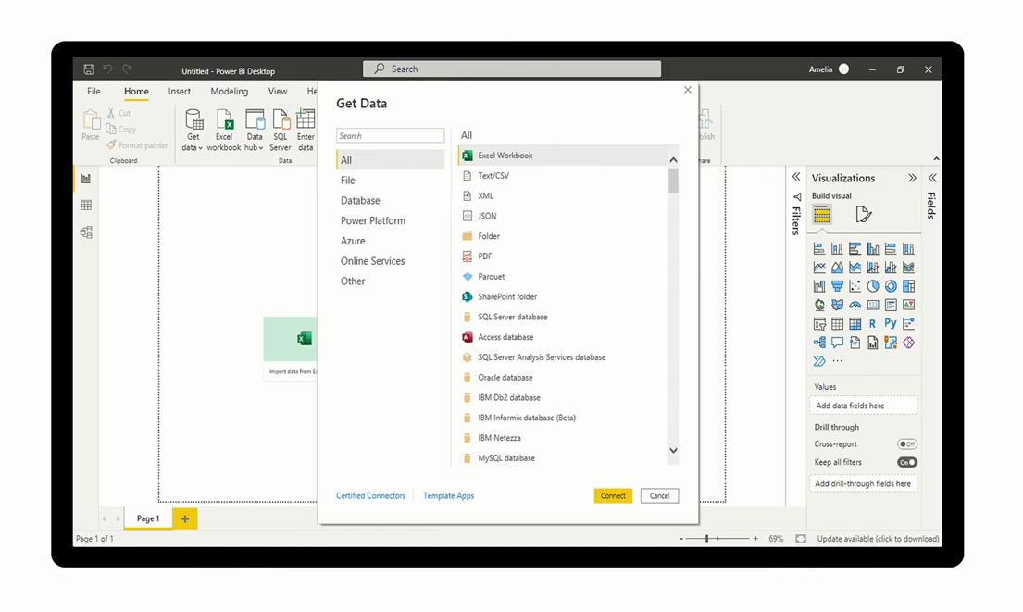
Power BI Connector

Slide 9
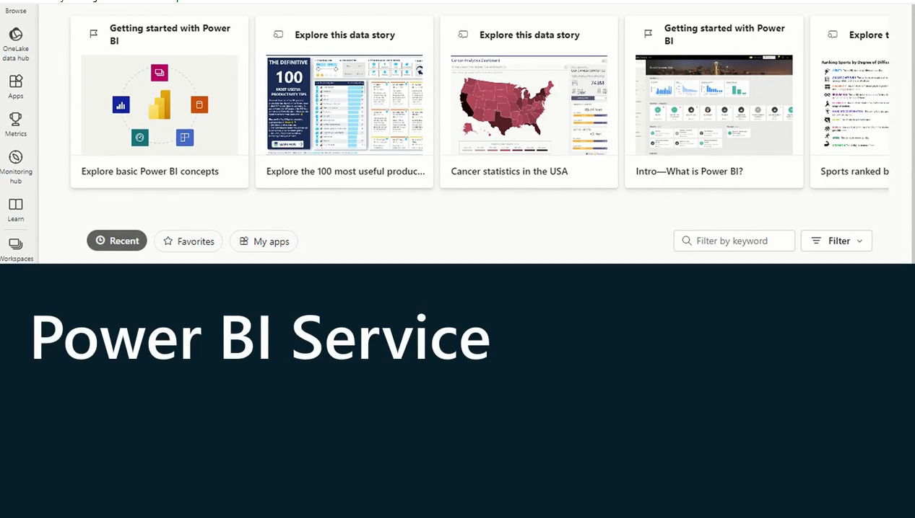

Slide 10


Slide 11
2
Power BI Workflow

Slide 12
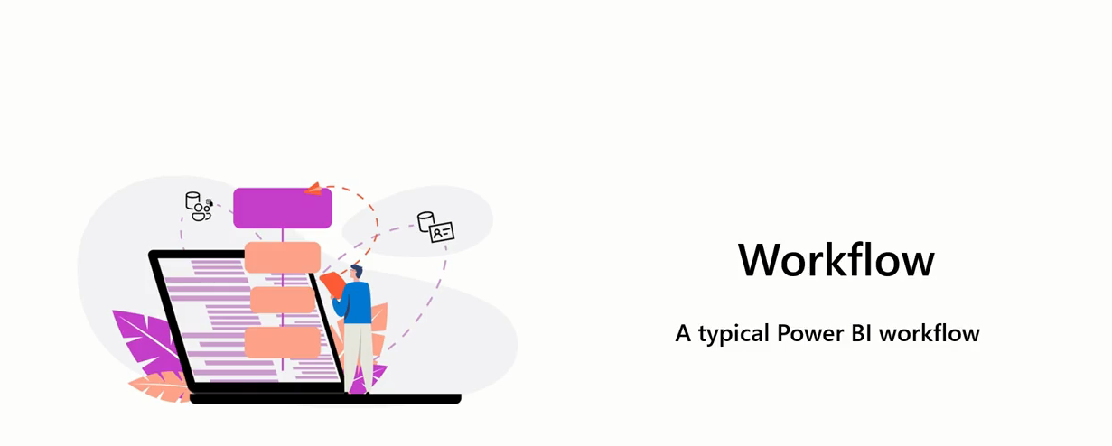

Slide 13
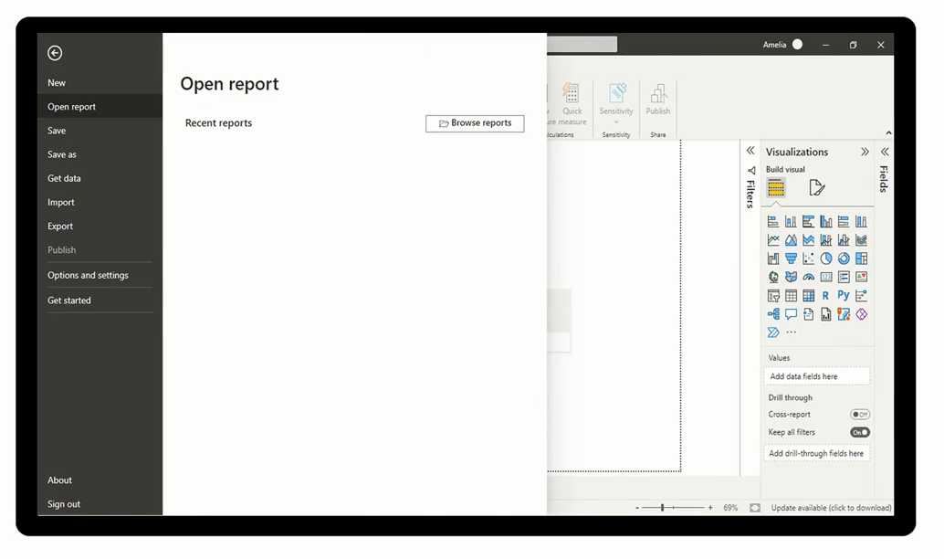
Report in Power BI Desktop

Slide 14
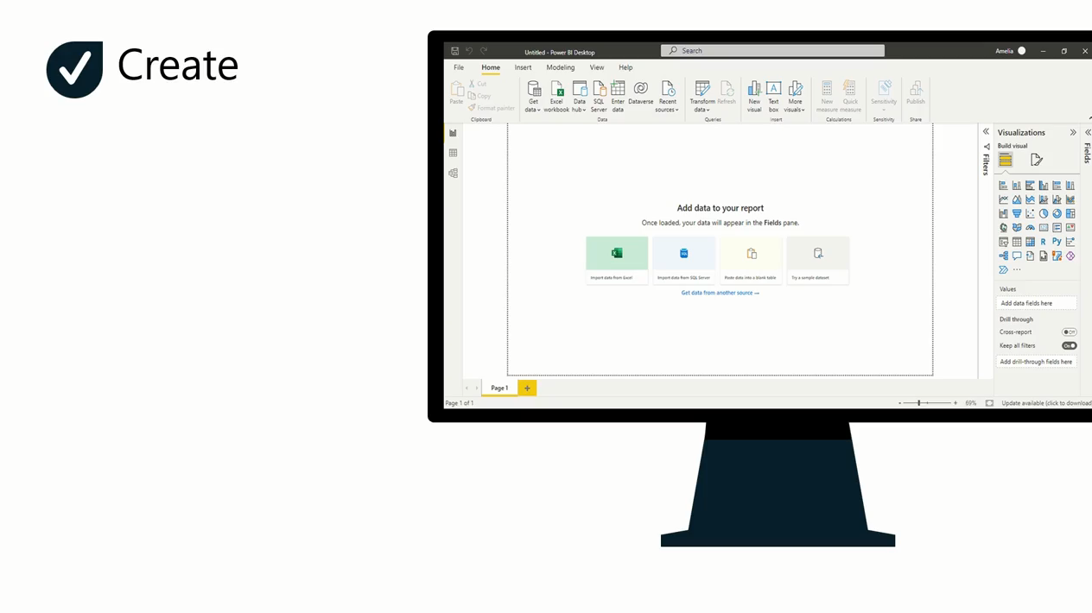

Slide 15
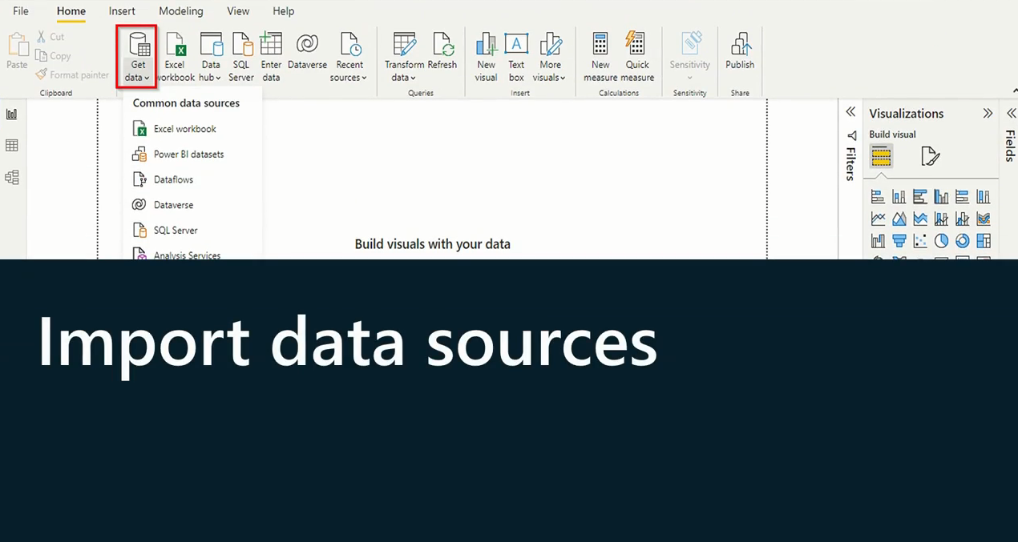

Slide 16
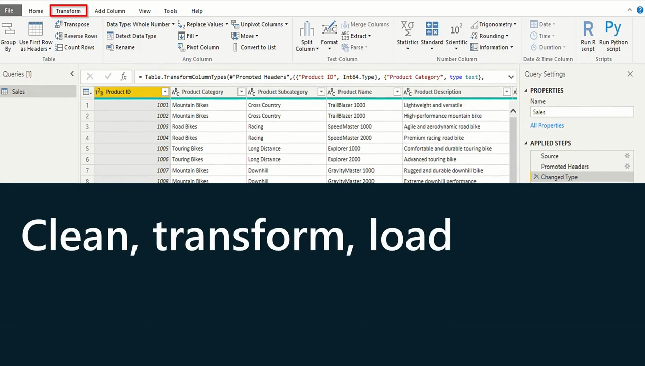

Slide 17
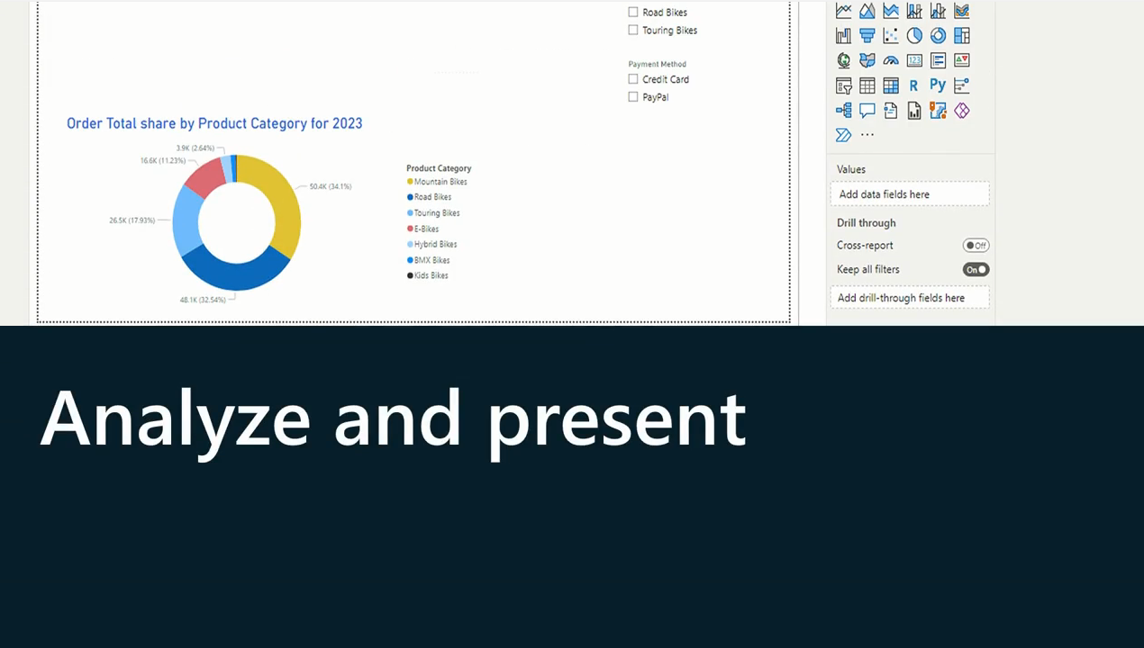

Slide 18
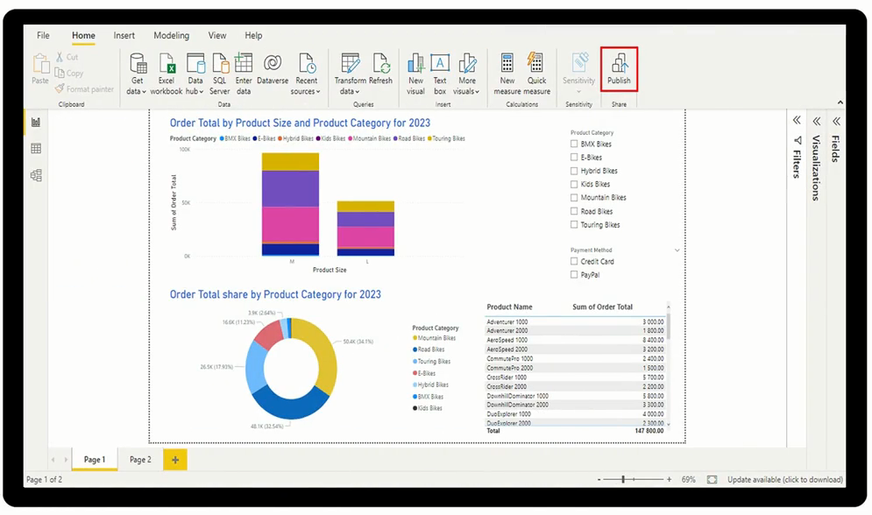
Publish to Power BI Service

Slide 19
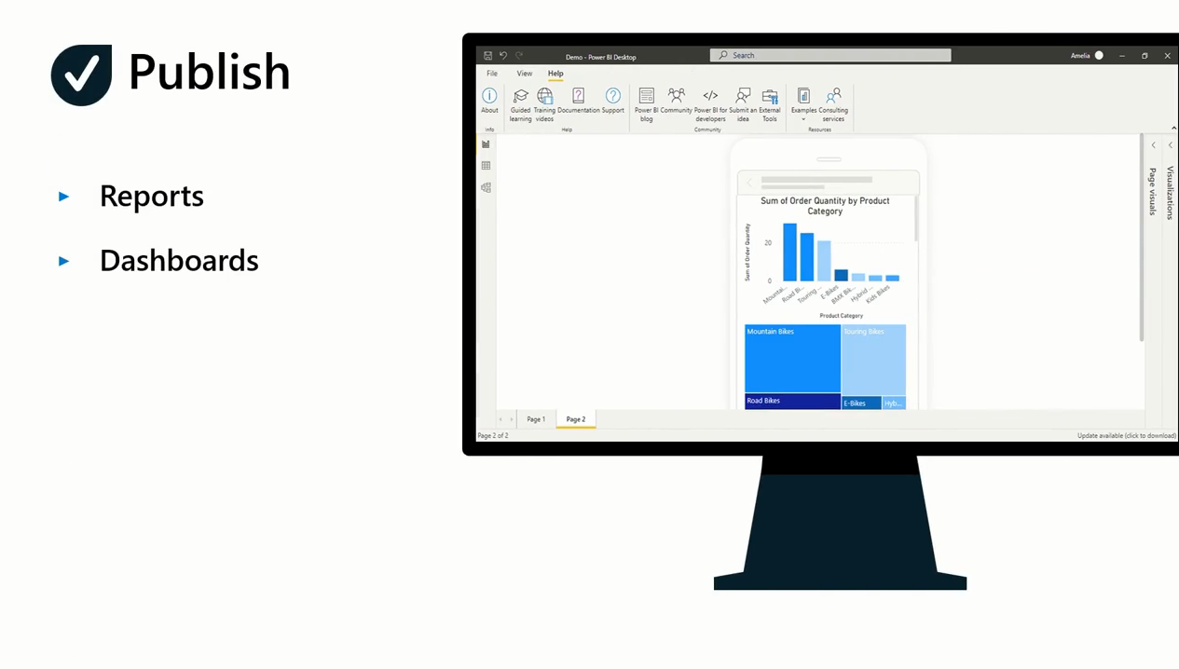

Slide 20
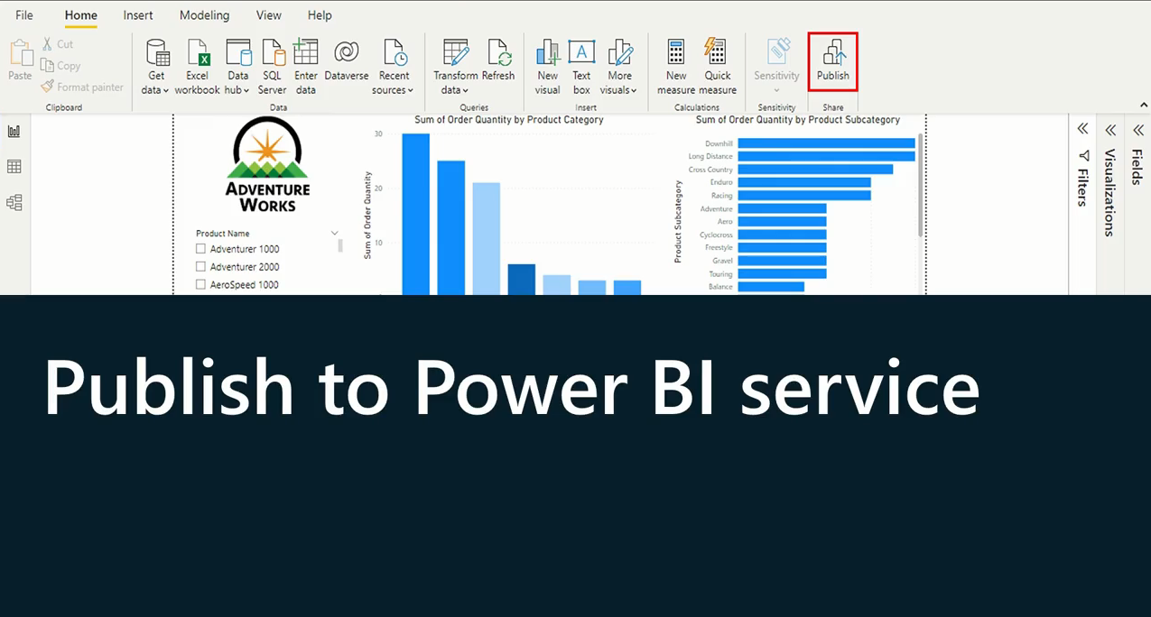

Slide 21
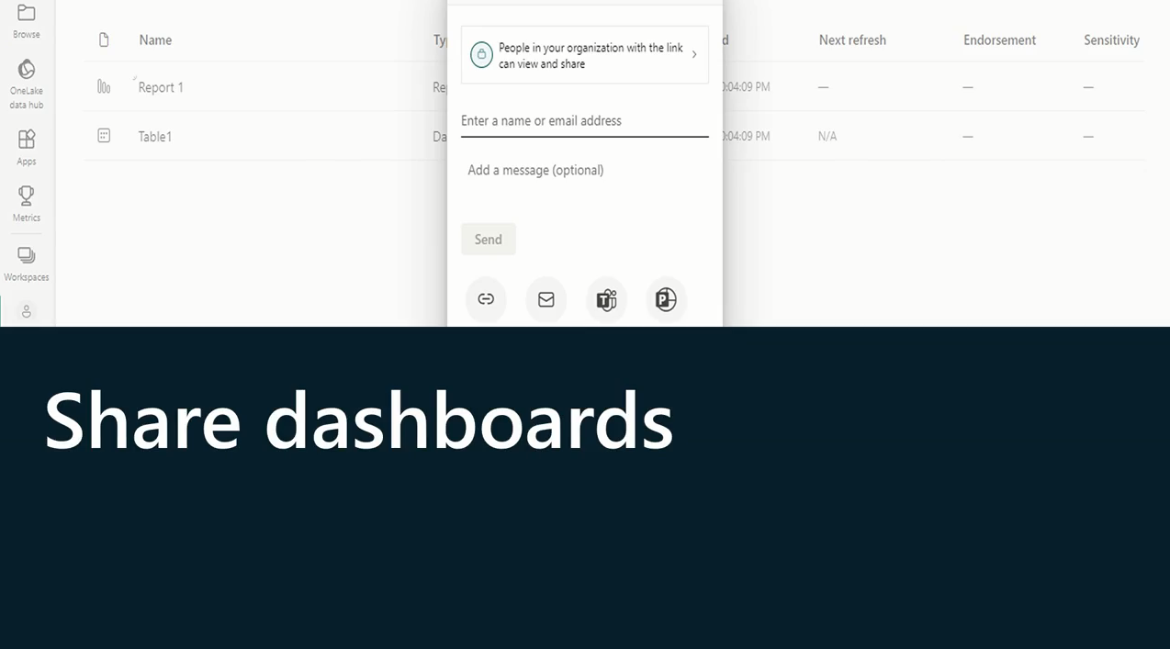

Slide 22
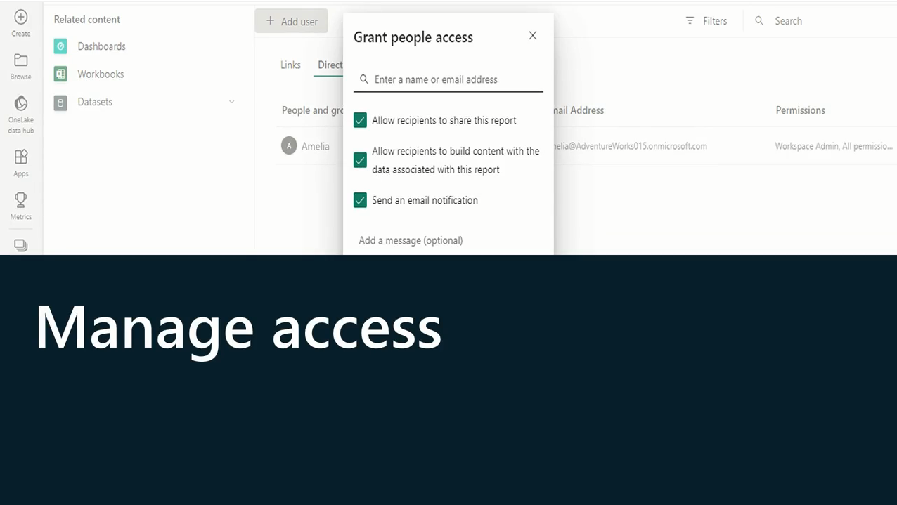

Slide 23
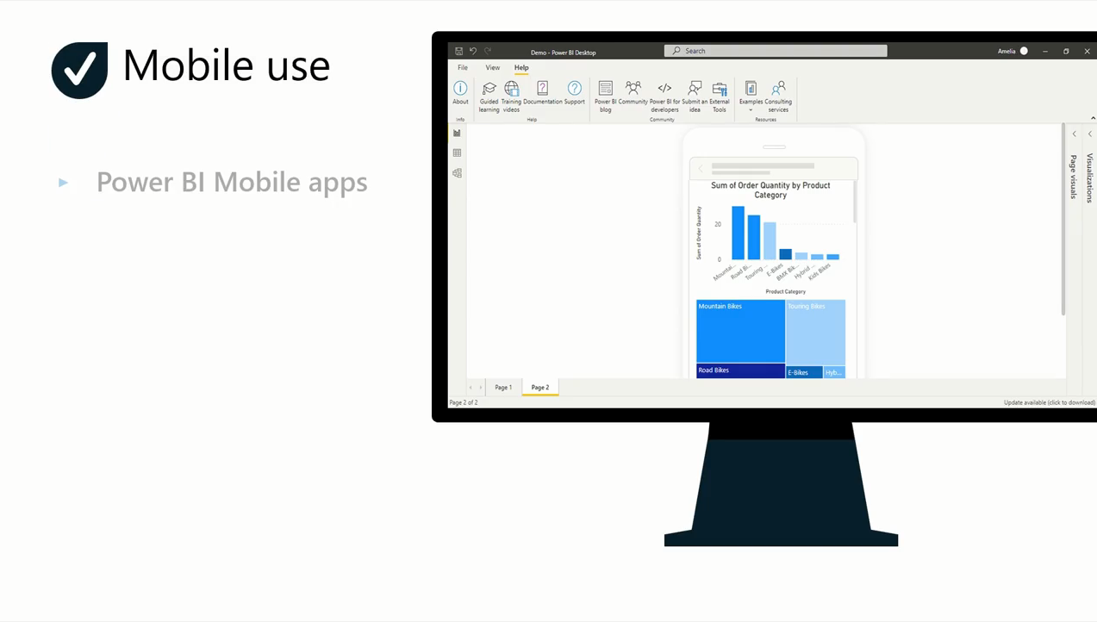

Slide 24


Slide 25
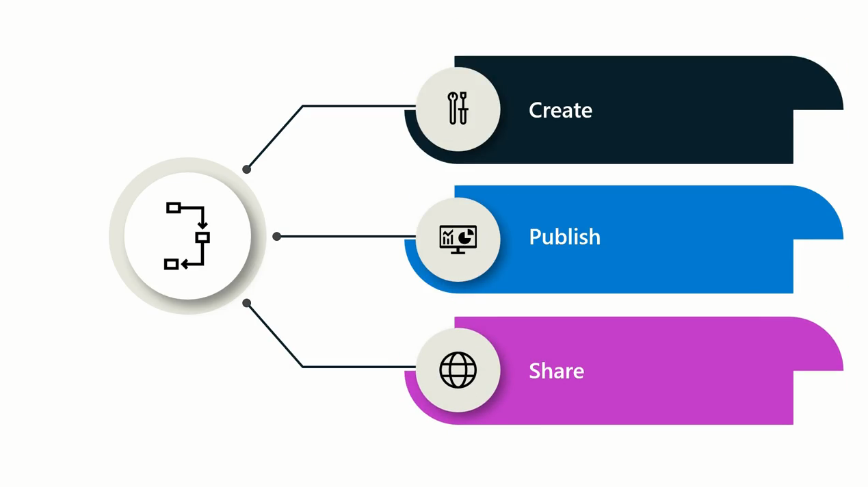
Workflow Summary

Slide 26
Question
Which of the following is the SaaS (Software as a Service) based web application of Microsoft Power BI?
Power BI Service
Power BI Apps
Power BI Desktop

Slide 27
Answer
Which of the following is the SaaS (Software as a Service) based web application of Microsoft Power BI?
Power BI Service
Power BI Apps
Power BI Desktop

Slide 28
3
Exercise 1: Mini Project in Power BI

Slide 29

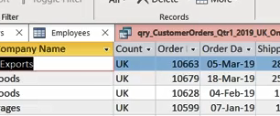
Exercise 1 (A,B,C,D,E,F,G( : Mini Project In Power BI

Slide 30


Slide 31
Question 1
Which product has strong reporting features and is typically used to begin a workflow in Power BI?
Microsoft Power BI Apps
Microsoft Power BI Service
Microsoft Power BI Desktop

Slide 32
Answer 1
Which product has strong reporting features and is typically used to begin a workflow in Power BI?
Microsoft Power BI Apps
Microsoft Power BI Service
Microsoft Power BI Desktop

Slide 33
Question 2
You want to publish your report and share your data with others by creating dashboards. Which of the following products would you use to accomplish this?
Microsoft Power BI Desktop
Microsoft Power BI Service
Microsoft Power BI Apps

Slide 34
Answer 2
You want to publish your report and share your data with others by creating dashboards. Which of the following products would you use to accomplish this?
Microsoft Power BI Desktop
Microsoft Power BI Service
Microsoft Power BI Apps

Slide 35
Question 3
True or False: The typical workflow in Microsoft Power BI starts with the creation of a report in Power BI Desktop.
True
False

Slide 36
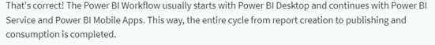
Answer 3
True or False: The typical workflow in Microsoft Power BI starts with the creation of a report in Power BI Desktop.
True
False

Slide 37


